Slide 1
Ray Tracing in Entertainment Industry
Tanaboon Tongbuasirilai
Dept. Computer Science
Kasetsart University
Week 1

Slide 2

Course outline
First half
Week 1 - Ray tracing overview
Week 2 - Ray tracing components
Week 3 - Image formation and rays
Week 4 - Basic shapes and intersections
Week 5 - Lighting and shadows
Week 6 - Geometric optics
Week 7 – Texture and reflection models

Slide 3
Course outline
Second half
Week 8 – Reflection models and indirect illuminations
Week 9 - Sampling techniques and reconstruction
Week 10 - Simple visual effects
Week 11 - Path tracing and Monte Carlo sampling
Week 12 - Variance reduction
Week 13 - Reflectance measurement
Week 14,15 - Advanced techniques in photo-realistic image synthesis

Slide 4
Course materials
Reading
Ray Tracing in One Weekend Series - raytracing.github.io – codes available
Lecture notes from https://ocw.mit.edu/courses/6-837-computer-graphics-fall-2012/pages/lecture-notes/
Introduction to Real-Time Ray Tracing (realtimerendering.com) - http://rtintro.realtimerendering.com/
Physically Based Rendering: From Theory to Implementation (pbr-book.org)
Ray tracing gem - www.realtimerendering.com/raytracinggems/
Data-driven approaches for sparse reflectance modeling and acquisition, Ph.d. thesis
Watching
Introduction to Ray tracing (Siggraph Frontier course)
Videos - https://youtube.com/playlist?list=PLUPhVMQuDB_a7ODdVCKj3C6-63PCE6ekm&si=qB2KTD6KolS15Tbq
Slides - https://drive.google.com/drive/folders/11cQDkO0fPLakZO0WaK2zrhxzUxm7F_e2

Slide 5
Grading
Participation – 15%
Presence in class
Being able to discuss
Assignment – 40%
8 class assignments
Submit before the next lecture
Presentation – 15 %
Project – 30%
Submit 2 rendered scenes
Resolution : width 3840 pixels
Aspect ratio : 16 : 9
Submission – 5% each
Good work – 5% each
Scene complexity and/or special effects – 2.5% each
New feature (not shown in the teaching codes) – 2.5% each

Slide 6
Course schedule
Lecture hour
12.00 – 15.00
Friday
Room 708
Midterm
No
Final
No

Slide 7

Week 1 – Ray tracing overview
Photo-realistic image synthesis
Light transport problem
Radiometry
Rendering equation

Slide 8

Photo-realistic image synthesis
Alternatives
Photo-realistic image generation
Realistic image synthesis
Physically-based image synthesis
Synthetic image generation
Definition : A computer-generated algorithm aiming to produce synthetic images that are indistinguishable from photographs.

Slide 9

Applications
Applicable to various industries that require
3D digital contents
Immersive experience
Product visualization, simulation
Examples …

Slide 10
What problem are we going to solve for the photo-realistic image synthesis ?
Light transport problem
We seek to solve the light transport problem that given a scene at a particular time we would like to find the equilibrium of photons (radiance) in the scene.
Photons contributed to the given scene is the solution of the light transport problem.
Light can be modelled by following :
Geometric optics
Wave optics
Quantum optics

Slide 11
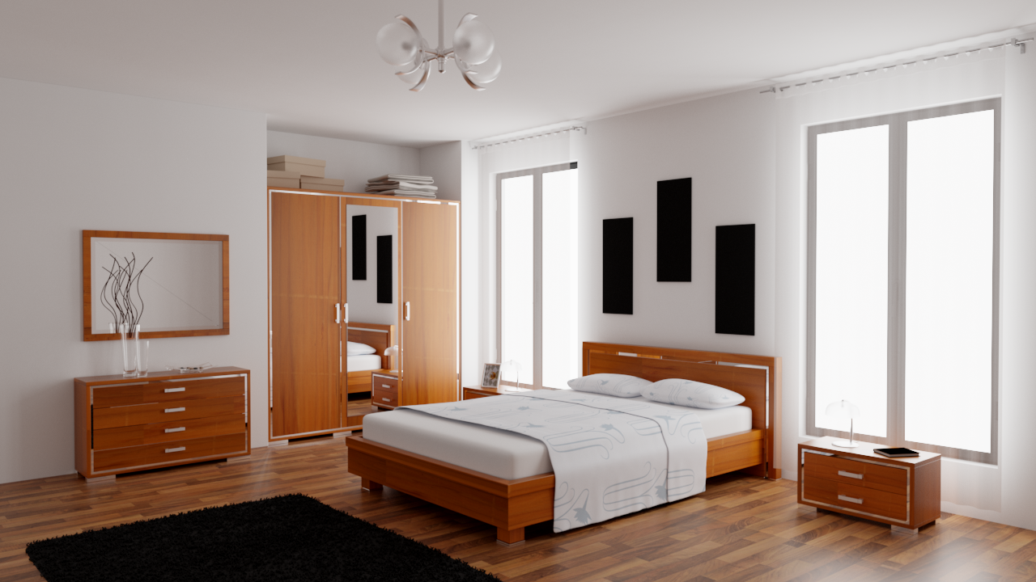

Notes:
Complexity of the light traveling in the scene.

Slide 12
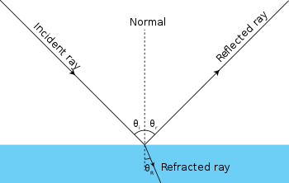
Geometric optics
https://en.wikipedia.org/wiki/Ray_%28optics%29
Notes:
How light can be simulated ?
geometric optics
wave optics

Slide 13
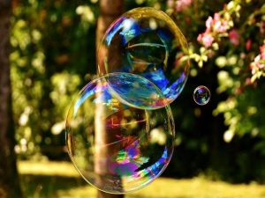
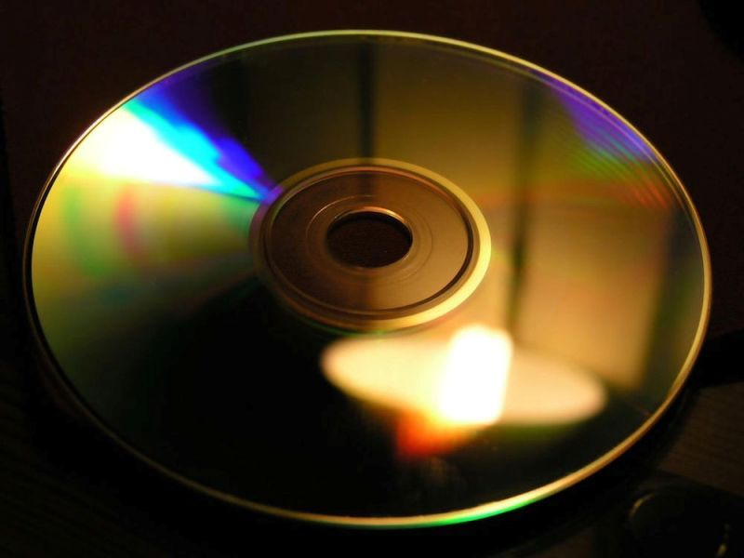
Wave optics
Interference
Diffraction
https://studiousguy.com/light-interference-examples/
https://studiousguy.com/diffraction-examples/

Slide 14
Solutions
Rasterization
https://en.wikipedia.org/wiki/Reyes_rendering
Less memory and computations required
Physically-plausible rendering
Fast and high quality at the time
Ray tracing
Radiosity
Photon mapping
Global Illumination

Slide 15
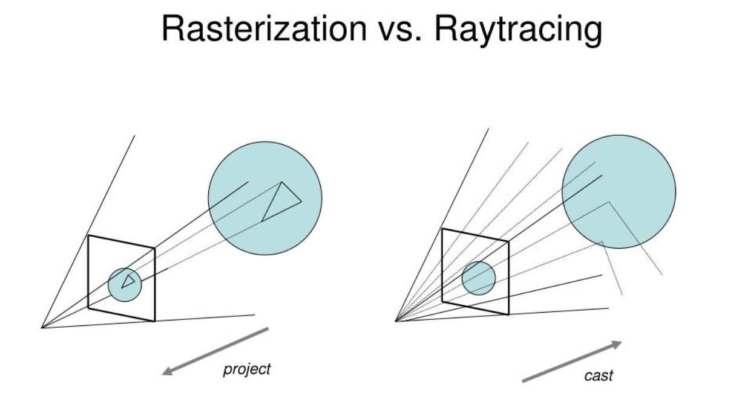
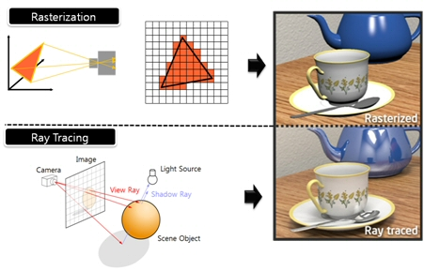
Comparisons
https://www.pixelsham.com/2019/10/24/whats-the-difference-between-ray-tracing-and-rasterization/

Slide 16
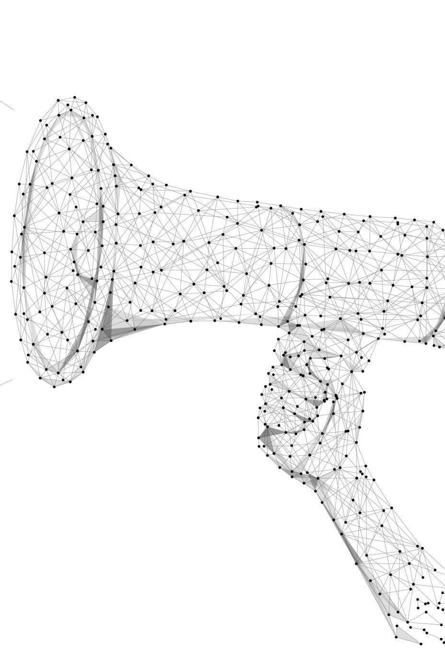
Ray Tracing Essentials Part 2: Rasterization versus Ray Tracing
www.youtube.com/watch?v=ynCxnR1i0QY

Slide 17
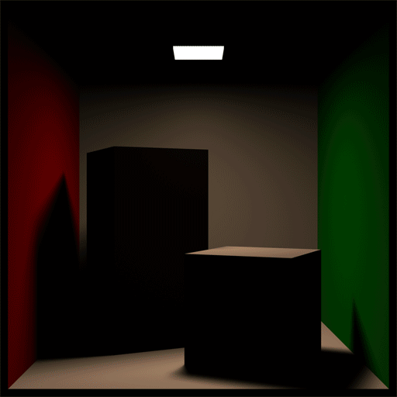
Radiosity
https://iwantthatcake.wordpress.com/2012/02/22/real-time-radiosity-geometrics-enlighten/
Notes:
Game with radiosity
http://blog.wolfire.com/2011/03/GDC-session-summary-Battlefield-3-Radiosity

Slide 18
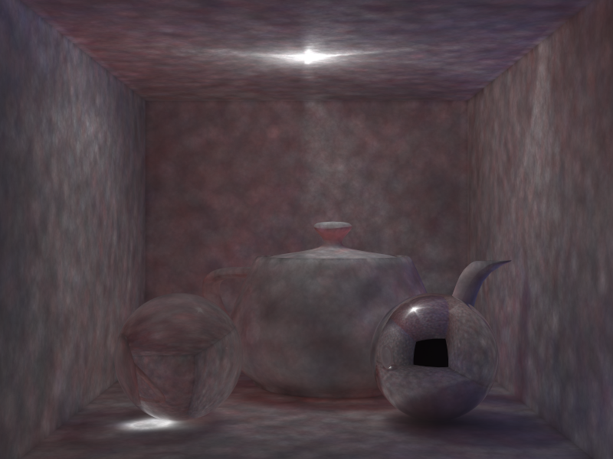
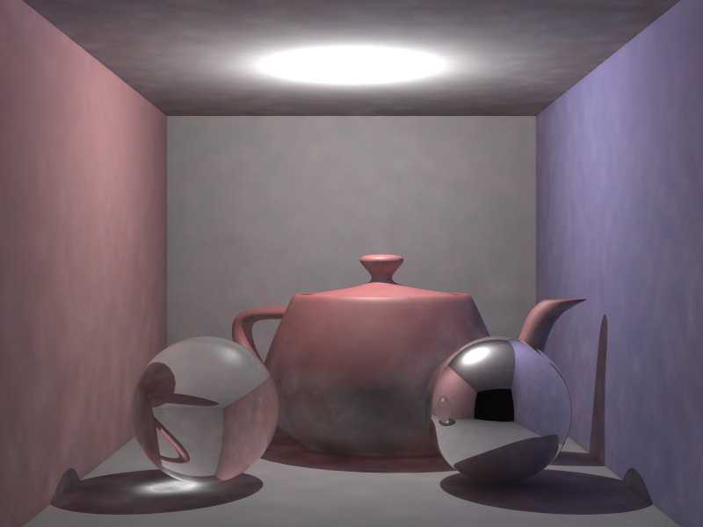
Photon mapping
http://sci.utah.edu/~mavinm/school/cs6620/index.php?prj=13

Slide 19
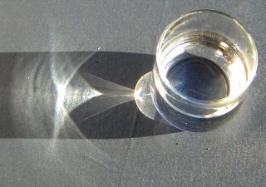
Global Illumination
Definition
Global illumination is the process of computing the color and quantity of all light — both direct and indirect — that is on visible surfaces in a scene.^{[1]}
Indirect illumination solver
Inter reflection, color bleeding
Soft shadows
Caustic effects
Etc. ?
[1] https://blogs.nvidia.com/blog/2022/08/04/direct-indirect-lighting/

Slide 20
Global Illumination
https://en.wikipedia.org/wiki/Global_illumination
Ray-based methods (Monte Carlo methods)
Patch-based methods (Finite element methods)
Hybrid (Multi-pass methods)

Slide 21
Global Illumination methods (classified by estimators)
Biased rendering
Focuses on Speed and Visual Appeal - Prioritizes rendering images quickly while achieving visually pleasing results.
Uses Shortcuts - Employs optimizations and algorithms to accelerate the rendering process. These shortcuts might introduce slight inaccuracies in the final image compared to a perfect simulation of light.
Good for Animations and Games - Due to its speed, biased rendering is well-suited for creating animations and real-time graphics in games.
Unbiased rendering
Prioritizes Accuracy and Realism - Aims to achieve the most physically accurate simulation of light possible, replicating how light interacts with surfaces in the real world.
No Shortcuts - Doesn't employ optimizations and calculates every light bounce to create a highly realistic image.
Slower Rendering Times - Because of the meticulous calculations, unbiased rendering can be significantly slower than biased rendering.
https://www.chaos.com/blog/the-truth-about-unbiased-rendering

Slide 22
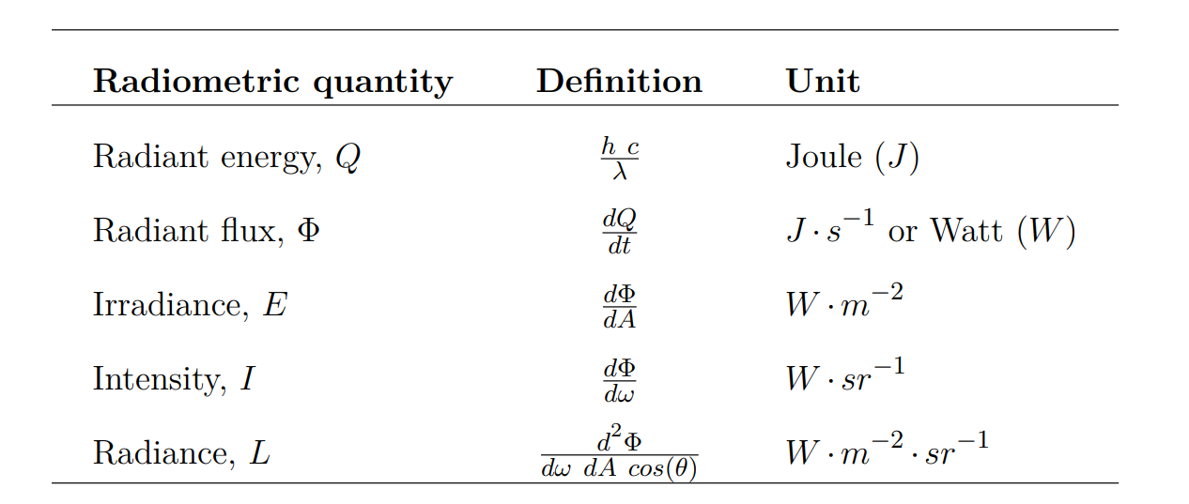
Basic radiometry
Notes:
Radiant energy = photon energy depending on the wavelength
Radiant flux = the amount of energy per differential time
Irradiance = density of energy (over an area)
Intensity = directional energy amount (over a solid angle)
Radiance = directional flux density (over an area, over a solid angle)

Slide 23
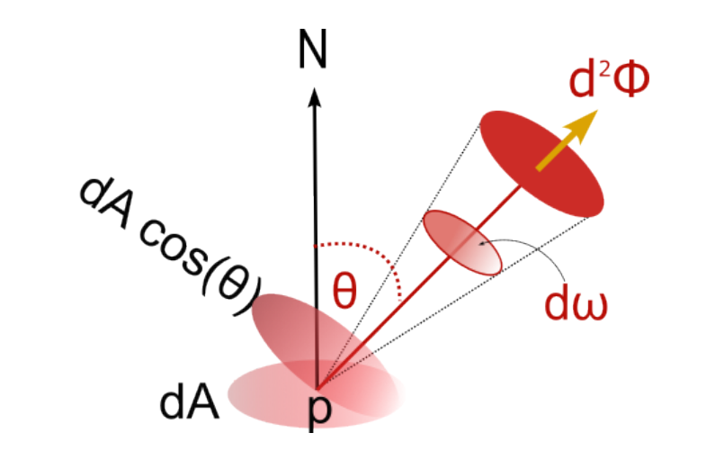
Radiometric quantities

Slide 24
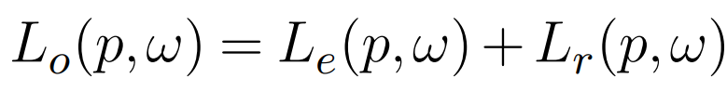
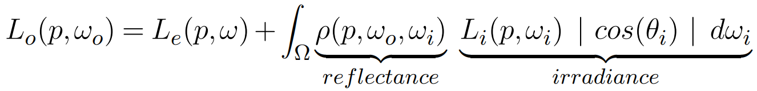
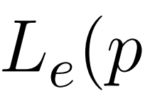
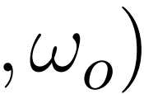
Rendering Equation
Notes:
Lo = observed L

Slide 25
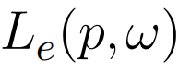

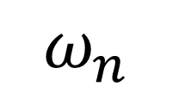
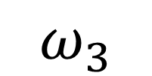
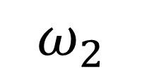
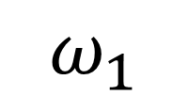
$$ω_{3}$$
$$ω_{2}$$
$$ω_{1}$$
$$ω_{n}$$

Slide 26
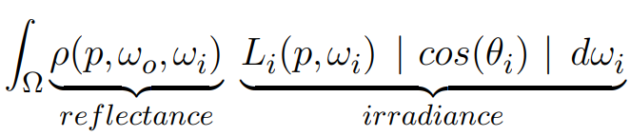
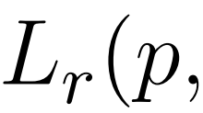
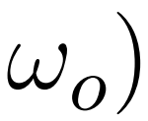
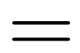
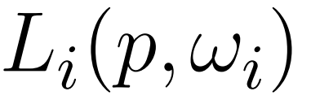
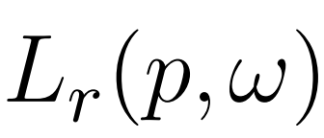

Slide 27
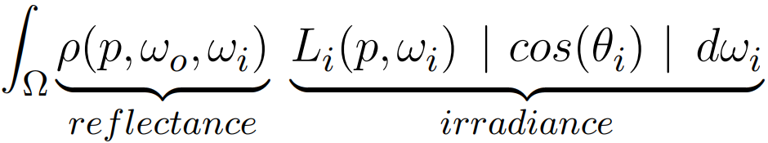

Slide 28
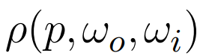

Slide 29
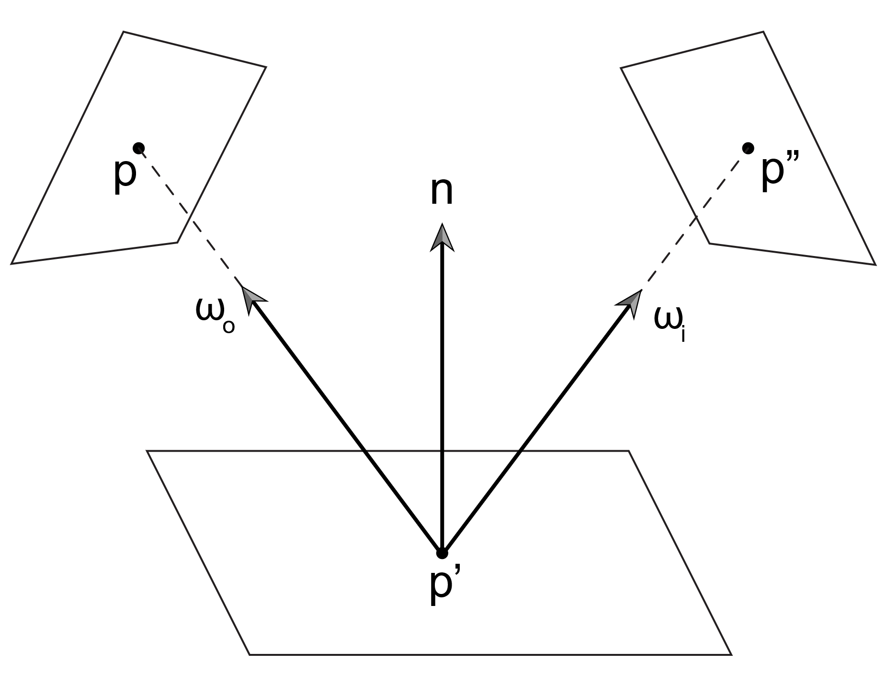
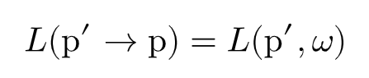
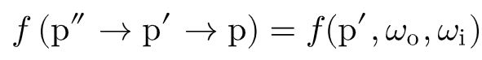
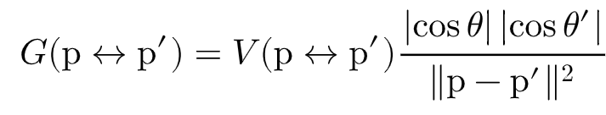
Analytical solution of the LTE

Slide 30
p
3
p
)
L
(p
p
)
0
p
e
3
2
3
(p
G
2
p
p
)
2
(p
p
G
2
1
f
1
(p
p
p
)
1
2
3
f
(p
p
)
p
0
1
2

Slide 31
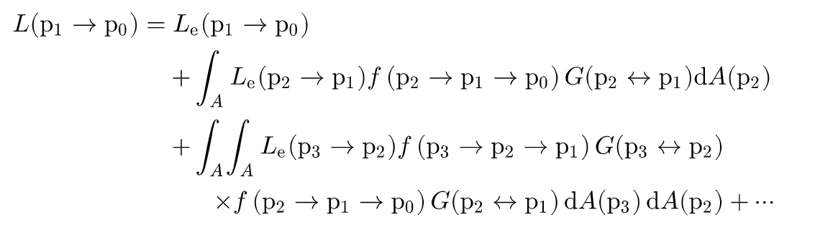
The integral over paths of length four

Slide 32
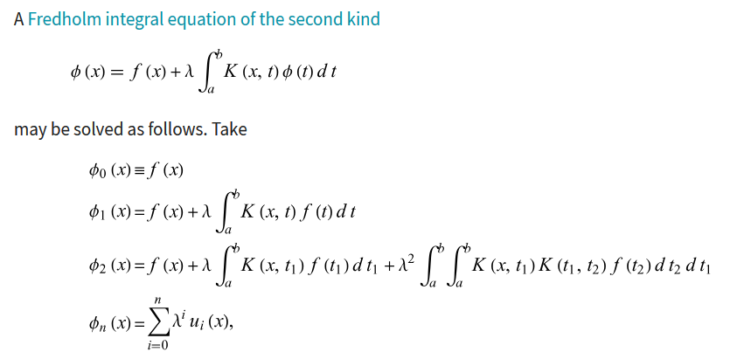
Fredholm integral equation of the second kind
https://mathworld.wolfram.com/IntegralEquationNeumannSeries.htmlb

Slide 33
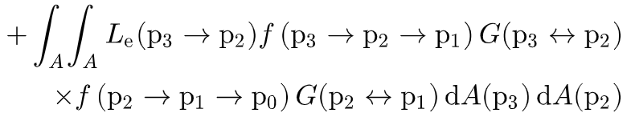
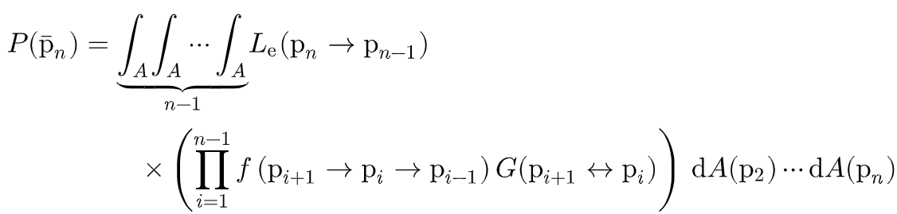
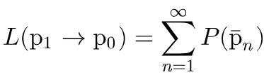
A solution

Slide 34
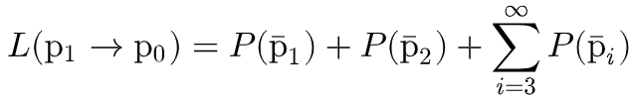
Path sampling
Monte Carlo integration
Emitted
radiance
Direct
lighting
Indirect
lighting

